Slide 1

Loop Statements (Part2)
Prof. Dr. Alp KUT
Asst. Prof. Dr. Derya BİRANT

Slide 2
OUTLINE
Loop Statements
  While - loop
  Do while - loop
  For - loop
Nested Loops
Examples

Slide 3
Loop Statements
Loop statements handle -controlled-repetition details
For – loop
While – loop
Do While – loop
for (initialization; loop_condition; step)
statement(s);
initialization;
while ( loop_condition )
{
statement(s);
step;
}
initialization;
do
{
statement(s);
step;
} while ( loop_condition )

Slide 4
for - while – do while Statements
int i=1;
while (i <= 10)
{
Console.Write("{0}", i);
i = i + 1;
}
1 2 3 4 5 6 7 8 9 10
int i=1;
do
{
Console.WriteLine("{0}", i);
i = i + 1;
} while (i <= 10);
for (int i = 1; i <= 10; i++)
Console.WriteLine("{0}", i);

Slide 5
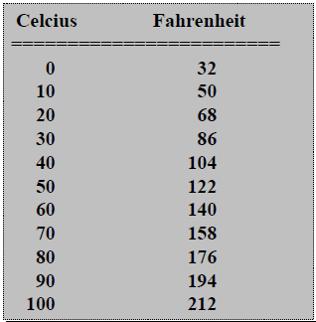

Question
Write a program that displays a table of temperatures in Celcius degrees and Fahrenheit degrees. The temperatures should be in the interval 0 to 100, with a step of 10ºC

Slide 6

Example: Bouncing Ball Problem
When a ball is dropped, it bounces to ½ of its previous height.
Write a program which simulates this
  Display number of each bounce and height
  Repeat until bounce height is very small (1 millimeter)
Type | Name
double | height
integer | bounce

Slide 7
Example: Bouncing Ball Problem
Algorithm Ball
Input: height of the ball
Output: current bounce number, height
Initialize bounce 0
Prompt for, read value for height
Display original height value
Loop:
  If height < 0.001, terminate
  Replace height with height / 2
  Add 1 to bounce
  Display bounce and height
End loop
End

Slide 8
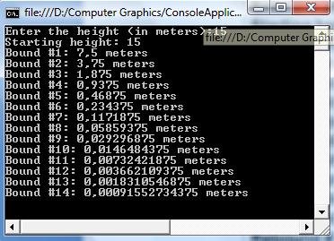
Example: Bouncing Ball
Program Code
int bounce = 0;
double height;
Console.Write("Enter the height (in meters):");
height = Convert.ToDouble(Console.ReadLine());
Console.WriteLine("Starting height: {0}", height);
while (height >= 0.001)
{
height = height / 2;
bounce = bounce + 1;
Console.WriteLine("Bound #{0}: {1} meters " , bounce, height);
}

Slide 9
Menu Handling
int option;
do {
Console.WriteLine("------------ MENU -----------");
Console.WriteLine("1 - Circle area and perimeter");
Console.WriteLine("2 - Rectangle area");
Console.WriteLine("3 - Triangle hypotenuse");
Console.WriteLine("4 - Quit");
Console.WriteLine("-----------------------------");
Console.WriteLine("Your option?");
option = Convert.ToInt16(Console.ReadLine());
switch (option)
{
case 1: break; // Circle area and perimeter
case 2: break; // Rectangle area
case 3: break; // Triangle hypotenuse
}
} while (option != 4);

Slide 10
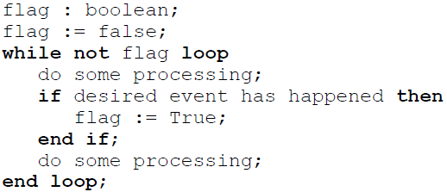
Flag-controlled Loops
A flag is a Boolean variable
  A value of False indicates that the desired event has not yet occurred
  True indicates that it has occurred

Slide 11
Flag-controlled Loops
bool DigitRead = false;
int c;
while (!DigitRead)
{
Console.WriteLine("Enter a digit");
c = Convert.ToInt16(Console.ReadLine());
if ((c >= 0) & (c <= 9))
DigitRead = true;
}
Console.WriteLine("Thanks");

Slide 12
Infinite Loops
The body of a while loop eventually must make the condition false
If not, it is called an infinite loop, which will execute until the user interrupts the program
This is a common logical (semantic) error
You should always double check the logic of a program to ensure that your loops will terminate normally

Slide 13
Infinite Loops
An example of an infinite loop:
int count = 1;
while (count <= 25){
Console.WriteLine(count);
count = count - 1;
}
This loop will continue executing until interrupted (Control-C) or until an underflow error occurs

Slide 14
Break Command
break can also be used to exit an infinite loop
int a = 1;
int count = 0;
while (a == 1)
{
if (count == 15)
break;
Console.WriteLine(count);
count = count + 1;
}

Slide 15
Nested Loops
When want to do something multiple times, and then do that multiple times
Examples:
  Printing a 2-dimensional table
  Printing the average mark of several exams

Slide 16
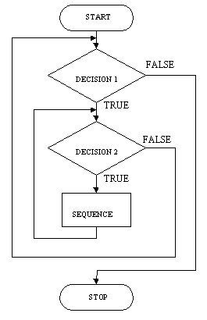
Nested Loops
That is, the body of a loop can contain another loop
For each iteration of the outer loop, the inner loop iterates completely
outer
loop
inner
loop

Slide 17
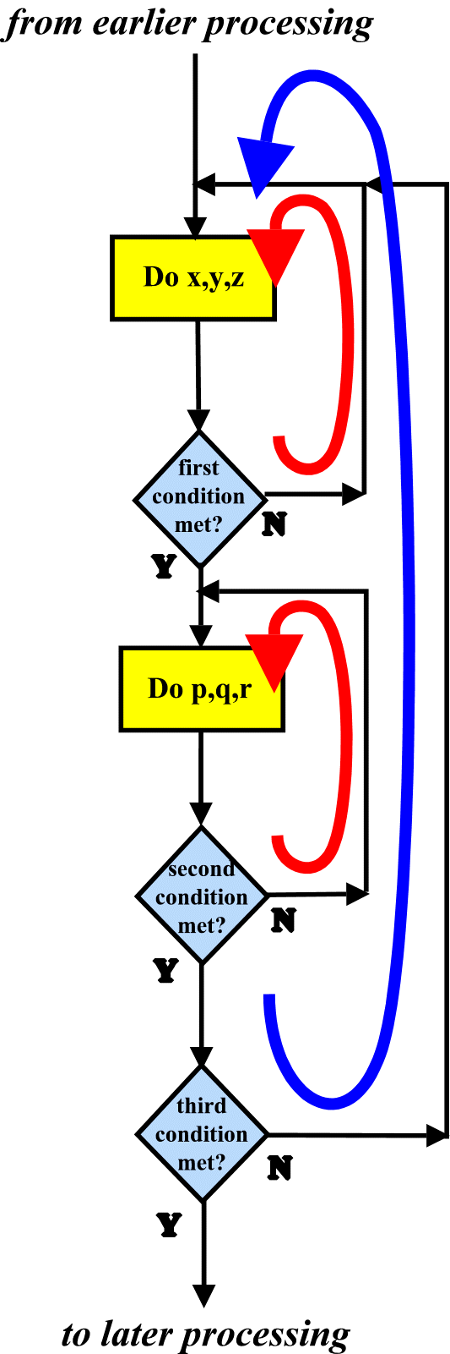
Nested Loops

Slide 18
Nested Loops
The following statement(s) is executes M * N times
The following statement(s) is executes M * N * T times
for (int i = 1; i <= M; i++) {
for (int j = 1; j <= N; j++)
statement(s);
}
for (int i = 1; i <= M; i++) {
for (int j = 1; j <= N; j++)
for (int j = 1; j <= T; j++)
statement(s);
}

Slide 19
Nested Loop Example
How many times will the string "Here" be printed?
count1 = 1;
while (count1 <= 10){
count2 = 1;
while (count2 <= 20) {
Console.WriteLine("here");
count2++;
}
count1++;
}
10 * 20 = 200

Slide 20
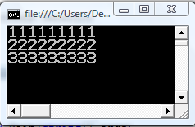
Example
What is the output of the following program?
for (int i = 1; i <= 3; i++)
{
for (int j = 1; j <= 9; j++)
Console.Write(i);
Console.WriteLine();
}

Slide 21
Example
Print the following two-dimensional table
1 2 3 4 5
1 2 3 4 5
1 2 3 4 5
i j
1 1
1 2
1 3
1 4
1 5
2 1
2 2
2 3
2 4
2 5
3 1
3 2
3 3
3 4
3 5
for (int i = 1; i <= 3; i++) {
for (int j = 1; j <= 5; j++)
Console.Write("{0} ", j);
Console.WriteLine();
}

Slide 22
Example
Write a program that prints the following output:
*****
*****
*****
for (int i = 1; i <= 3; i++) {
for (int j = 1; j <= 5; j++)
Console.Write("*");
Console.WriteLine();
}

Slide 23
Example
Write a program that prints the following output:
*
**
***
****
*****
for (int i = 1; i <= 5; i++) {
for (int j = 1; j <= i; j++)
Console.Write("*");
Console.WriteLine();
}

Slide 24
Example
Write a program that prints the following output:
*******
*****
***
*
int yildiz_sayisi = 7;
int bosluk_sayisi = 0;
for (int i = 1; i <= 4; i++)
{
for (int j = 1; j <= bosluk_sayisi; j++)
Console.Write(" ");
for (int j = 1; j <= yildiz_sayisi; j++)
Console.Write("*");
Console.WriteLine();
yildiz_sayisi = yildiz_sayisi - 2;
bosluk_sayisi = bosluk_sayisi + 2;
}

